Slide 1

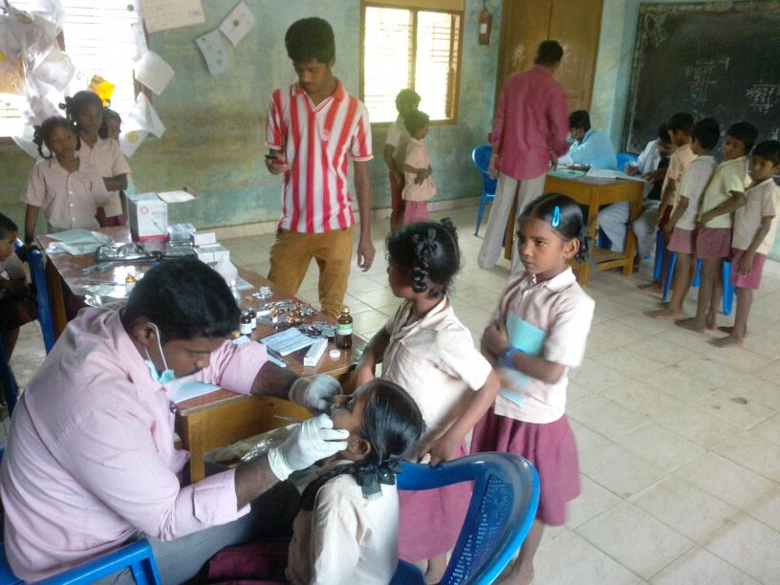

Weekly Iron & Folic Acid Supplementation
WORKFLOW

Slide 2
Weekly Iron & Folic Acid Supplementation workflow
Schools under various districts enter the following data on a monthly basis based on consumption by students ( classes 6 to 12), Teachers and staffs.
Basic Details
IFA Consumption
Albendazole Table Consumption
Students with moderate/severe anemia (based on physical checkup only)
Nutrition & Health Education
Adverse effects of IFA Consumption
Supplement Entry
Stock Details
SCHOOL
The CDPO enters supplement details and updates stock details for AWC’s and forwards to district level
CDPO
This data is sent to BMOH for verification
ACMOH
BMOH
The ACMOH views and forwards to district level
The BMOH only updates STOCK DETAILS and forwards
View the entire report of School
HEALTH DISTRICT
Circle SI

Slide 3
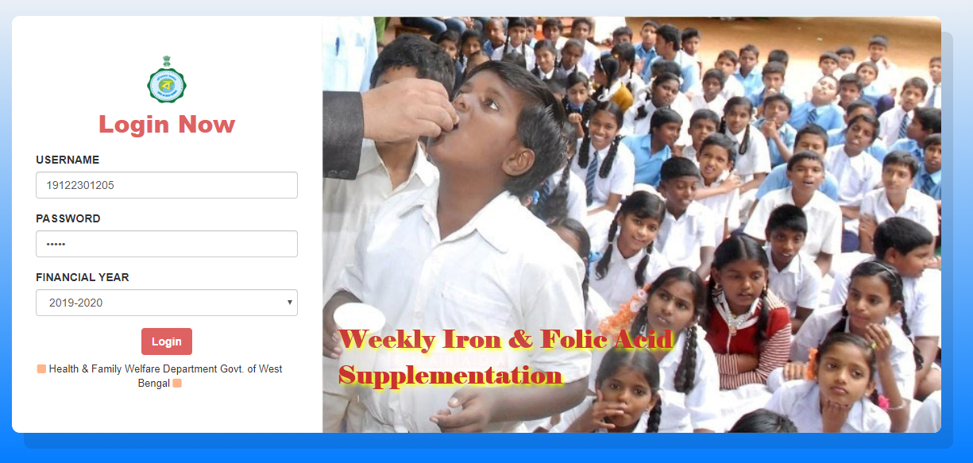
Weekly Iron & Folic Acid Supplementation workflow
School User Login to WIFS portal with their unique User credential

Slide 4
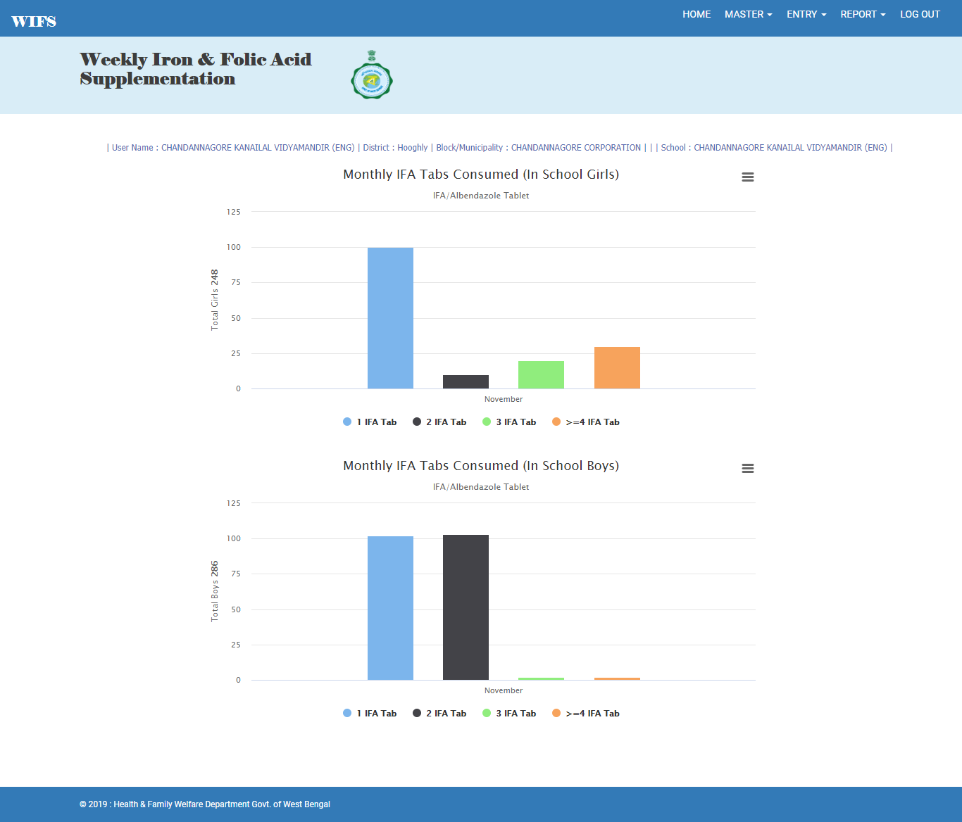
Weekly Iron & Folic Acid Supplementation workflow
School User redirected to the home page

Slide 5
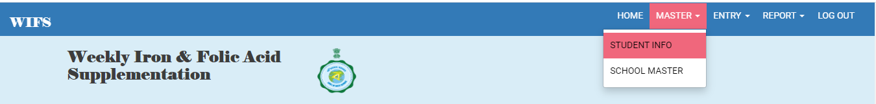
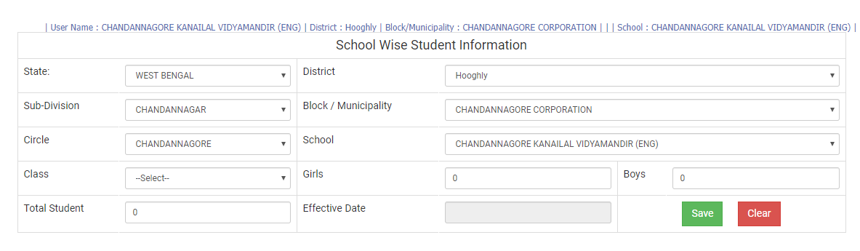
Weekly Iron & Folic Acid Supplementation workflow
School User clicks on ‘Student Info’ from Master main menu
School User redirected to the Student information page

Slide 6
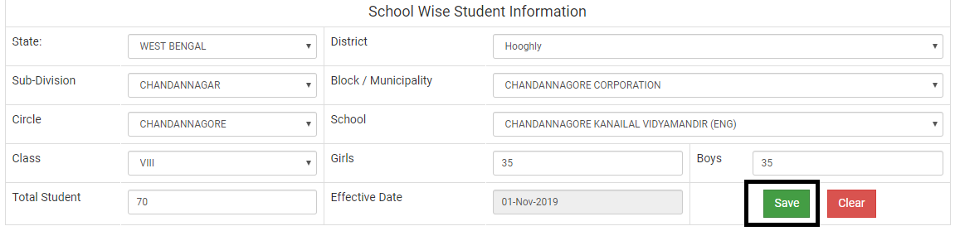
Weekly Iron & Folic Acid Supplementation workflow
User enters student information from Class VI to Class XII
Student information Saves accordingly

Slide 7
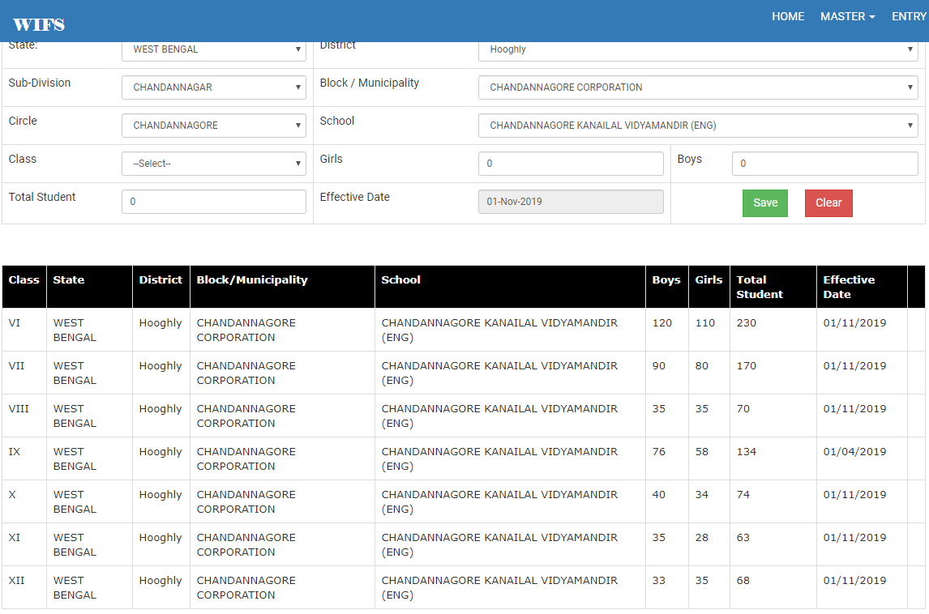
Weekly Iron & Folic Acid Supplementation workflow
Student Information of each class stored accordingly

Slide 8
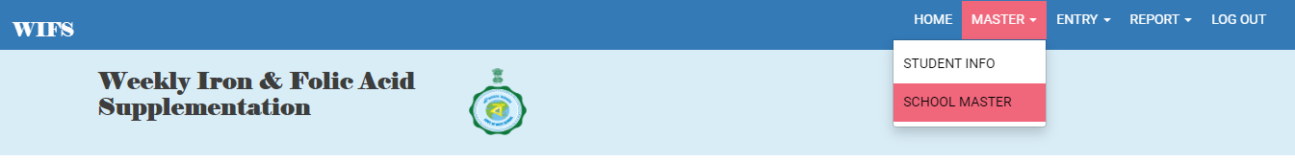
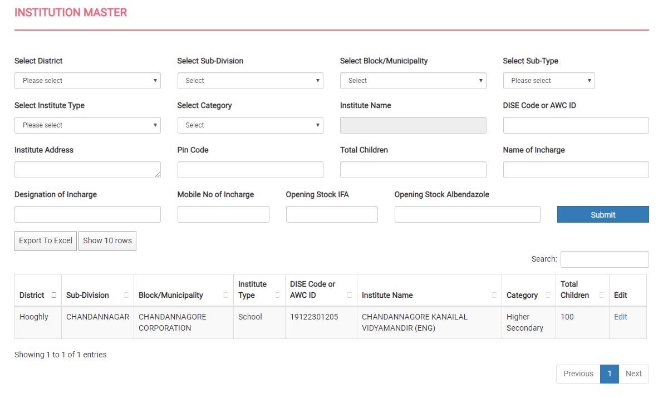
Weekly Iron & Folic Acid Supplementation workflow
School User clicks on ‘School Master’ from Master main menu
School User redirected to the School Master page

Slide 9
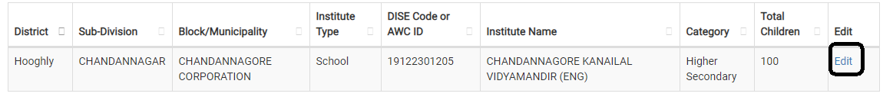
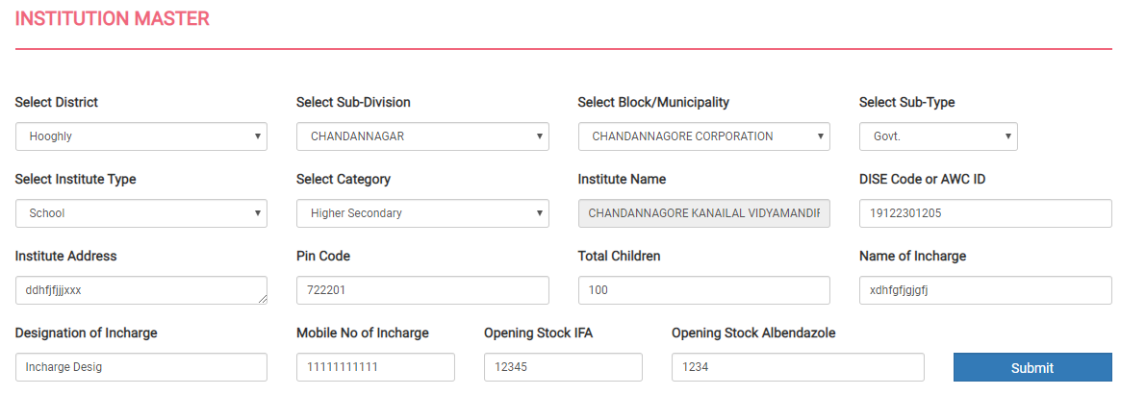
Weekly Iron & Folic Acid Supplementation workflow
User have to click on edit to update the school master as few data are not fetched from old databases
User will add the missing details and click on Submit button. User cannot add Supplement Entry without adding this missing details

Slide 10
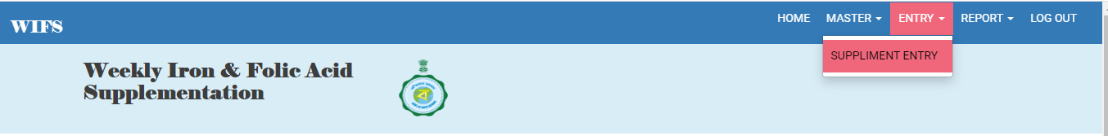
Weekly Iron & Folic Acid Supplementation workflow
School User clicks on ‘Supplement Entry’ from Master main menu

Slide 11
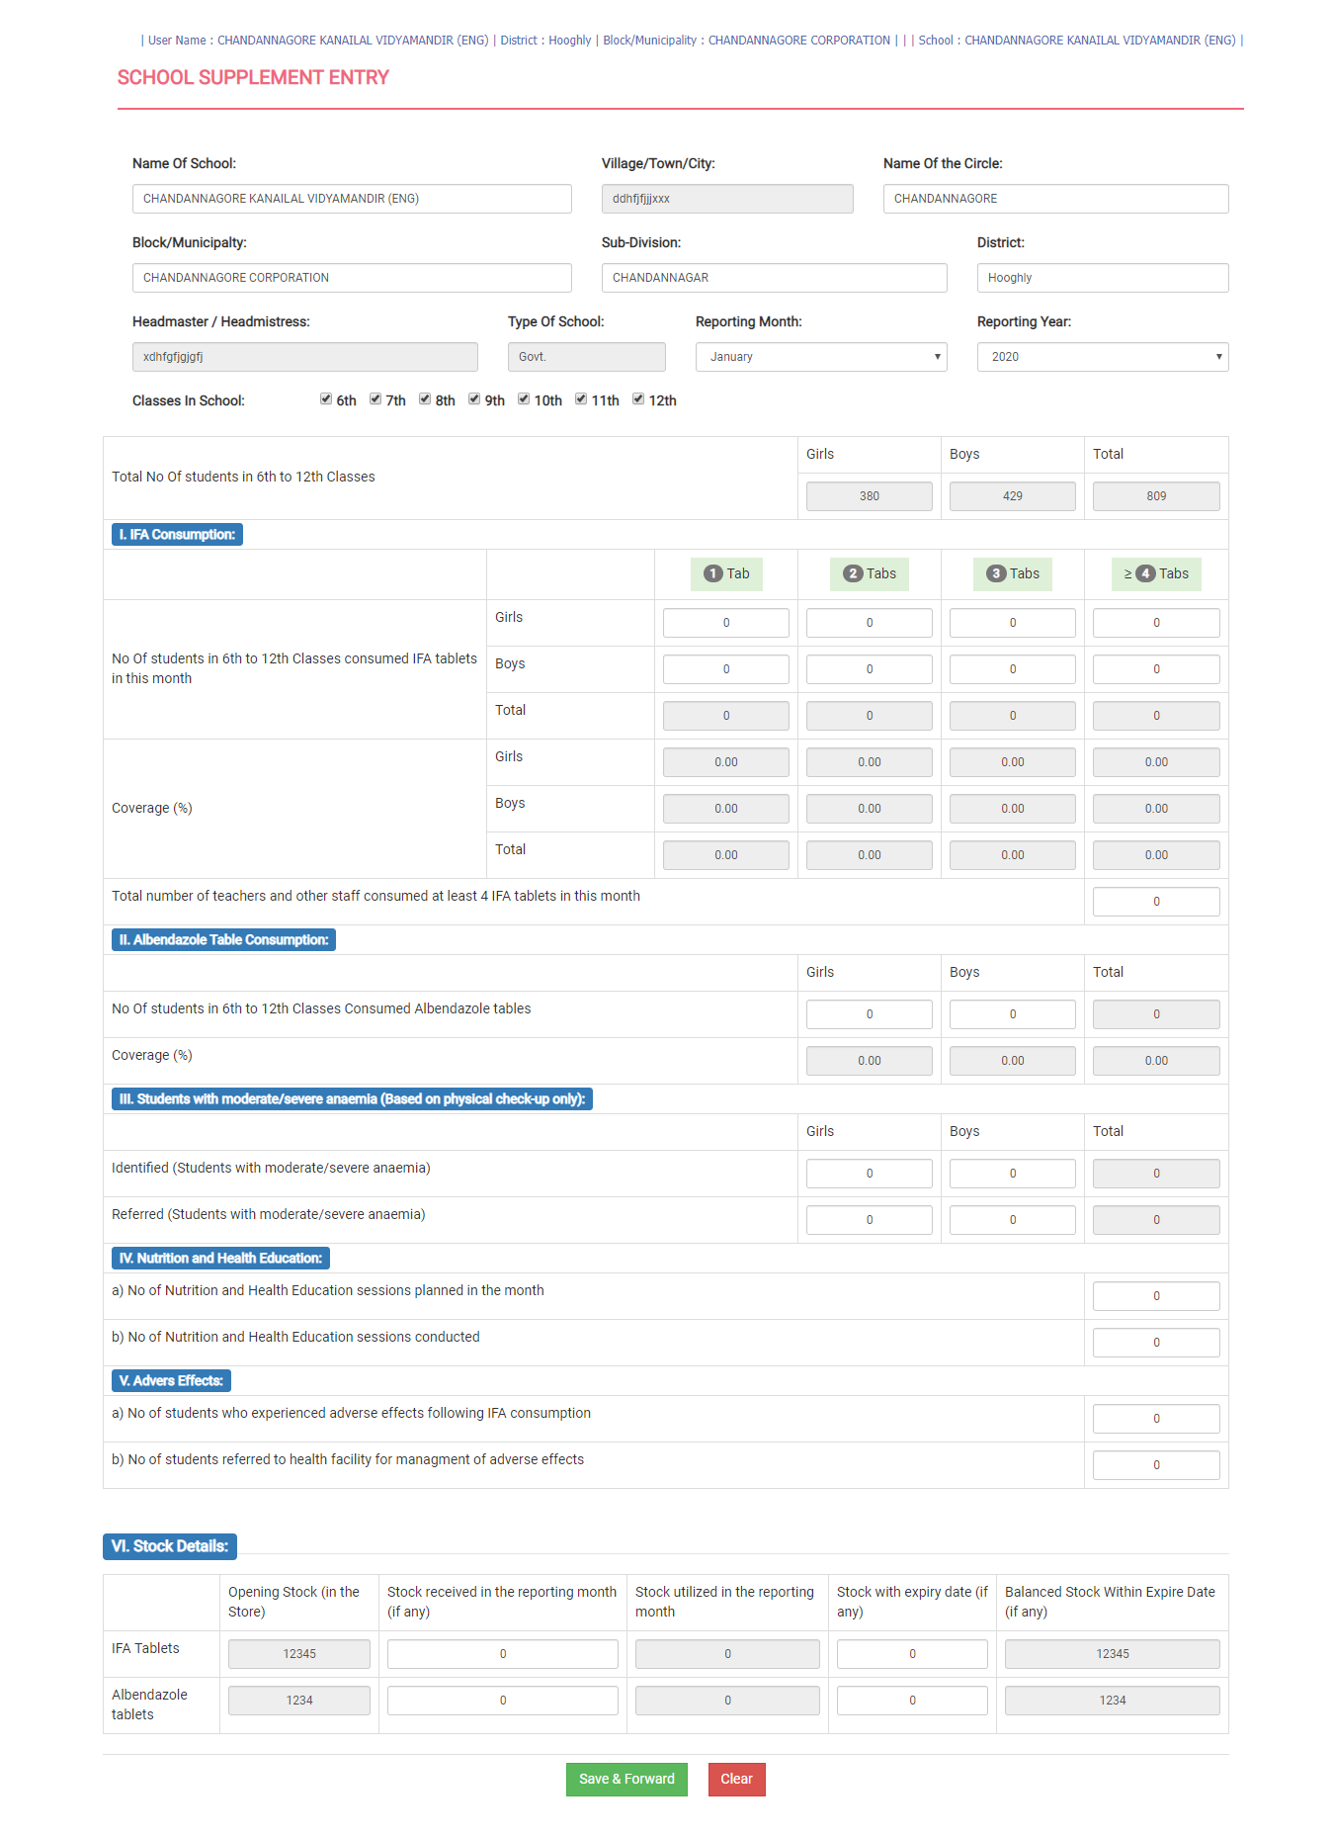
Weekly Iron & Folic Acid Supplementation workflow
School User redirected to the Supplement Entry page

Slide 12
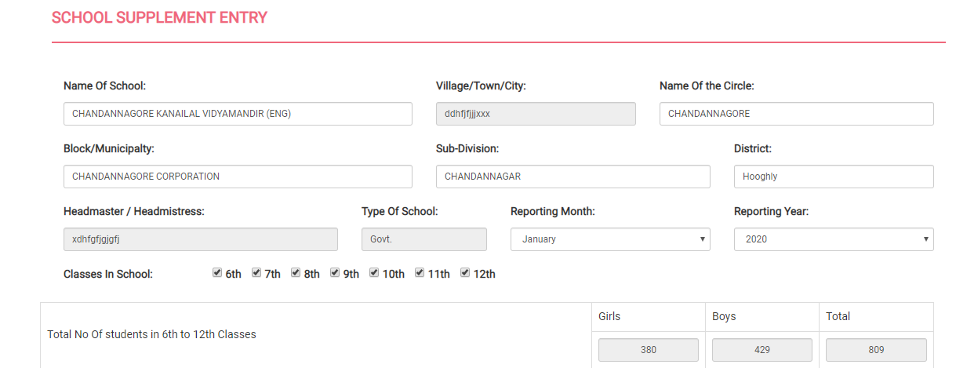
Weekly Iron & Folic Acid Supplementation workflow
In ‘Supplement Entry’ page the School user will view Name of School, Village/Town/City, Block/ Municipality, Sub-Division, District, Type of School and Headmaster / Headmistress which was auto fetched. Now User will select the Reporting Month and Years and select the Classes in School if required by default 6th to 12th classes are selected except 5th class. User can deselect any classes if required which will decrease the total student count

Slide 13
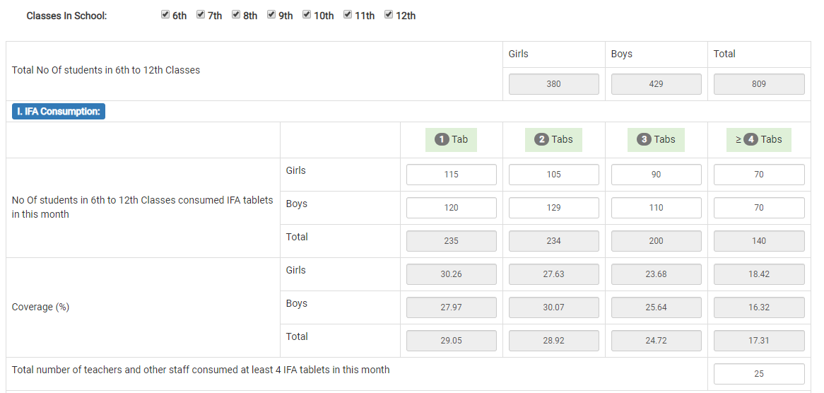
Weekly Iron & Folic Acid Supplementation workflow
The next section User will fill up IFA Consumption. Over here user will enter No Of students in 6th to 12th Classes consuming at least 4 IFA tablets in this month which populates total number of student and its Coverage in percentage. User will also enters Total number of teachers and other staff consuming at least 4 IFA tablets in this month

Slide 14
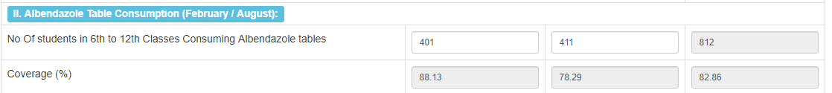
Weekly Iron & Folic Acid Supplementation workflow
The next section User will fill up Albendazole Table Consumption (February / August). Over here User will enters No Of students in 6th to 12th Classes Consuming Albendazole tablets which populates total number of student and its Coverage in percentage

Slide 15
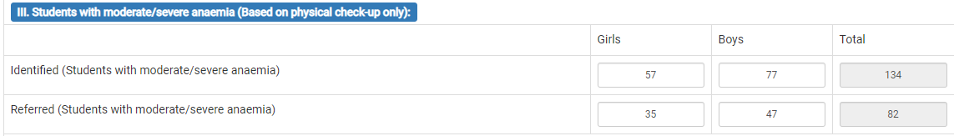
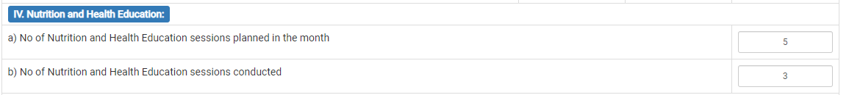
Weekly Iron & Folic Acid Supplementation workflow
The next section User will fill up Students with moderate/severe anemia (Based on physical check-up only). Over here User will first fill up Identified (Students with moderate/severe anemia) of total number of girls and boys which populates total number of student with moderate/severe anemia. Then User will enters total numbers of girl and boy students for Referred (Students with moderate/severe anemia) which populates total number of student for referred
The next section User will fill up Nutrition and Health Education. Over here they will fill up "No of Nutrition and Health Education sessions planned in the month" and "No of Nutrition and Health Education sessions conducted"

Slide 16
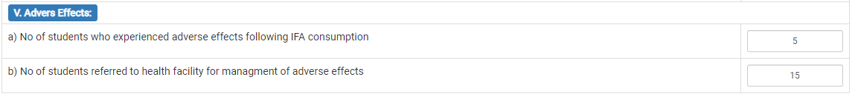
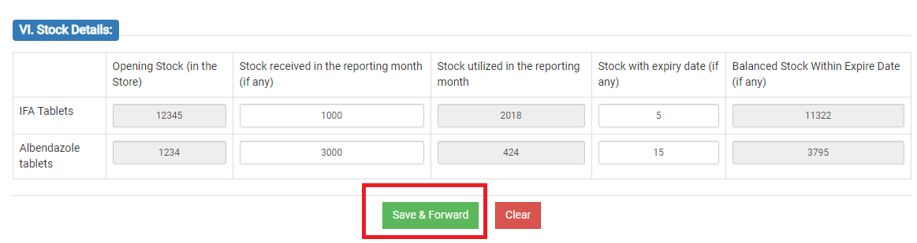
Weekly Iron & Folic Acid Supplementation workflow
Finally User will fill up is Adverse Effects. Over here they will fill up "No of students who experienced adverse effects following IFA consumption" and "No of students referred to health facility for management of adverse effects".
The Final Section is where the School User will input details about the stock details of IFA and Albendazole tablets which include Opening Stock (Auto populated), Stock received in the month (if any), Stock utilized in the months(Auto populated), Balance Stock with expiry date and Stock needed (if any). After filling up the details the School User will click on ‘Save & Forward’ to save the information and forward to send the details to BMOH for verification.

Slide 17
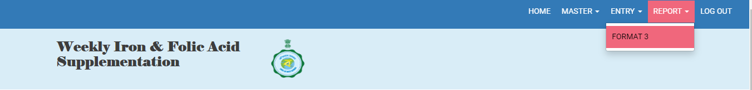
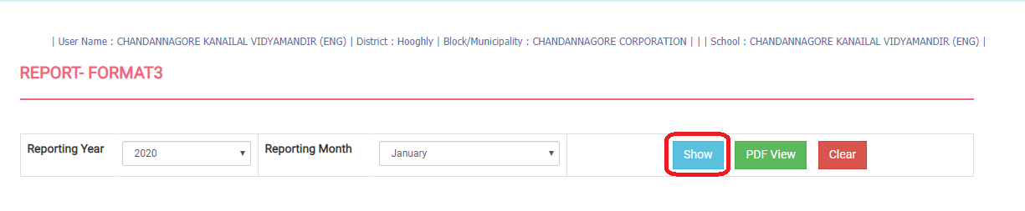
Weekly Iron & Folic Acid Supplementation workflow
School User Clicks on Format 3 from Report Main Menu
School User Redirected to the Format 3 Page

Slide 18
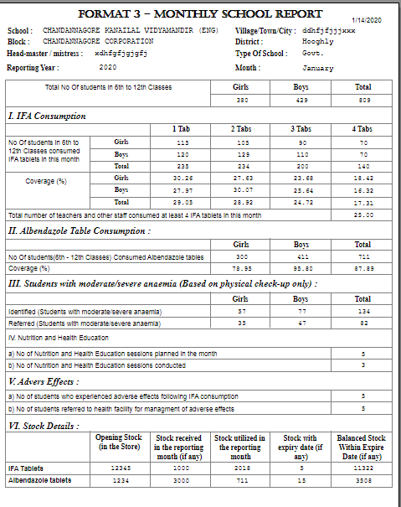
Weekly Iron & Folic Acid Supplementation workflow
User click on Show button after choosing required Reporting Year & Month. Report will open in a separate page for print

Slide 19
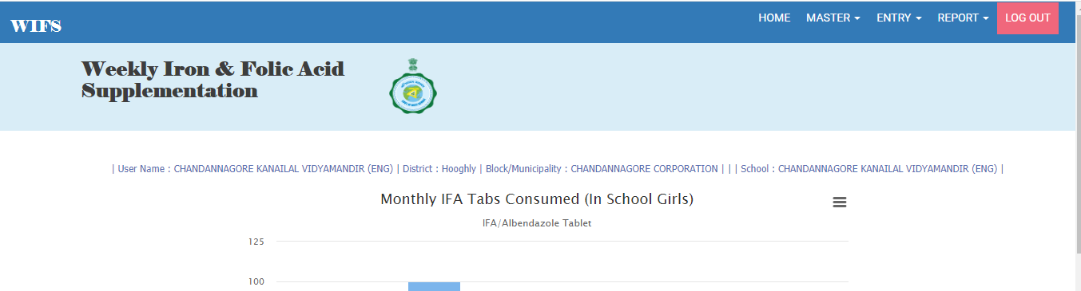
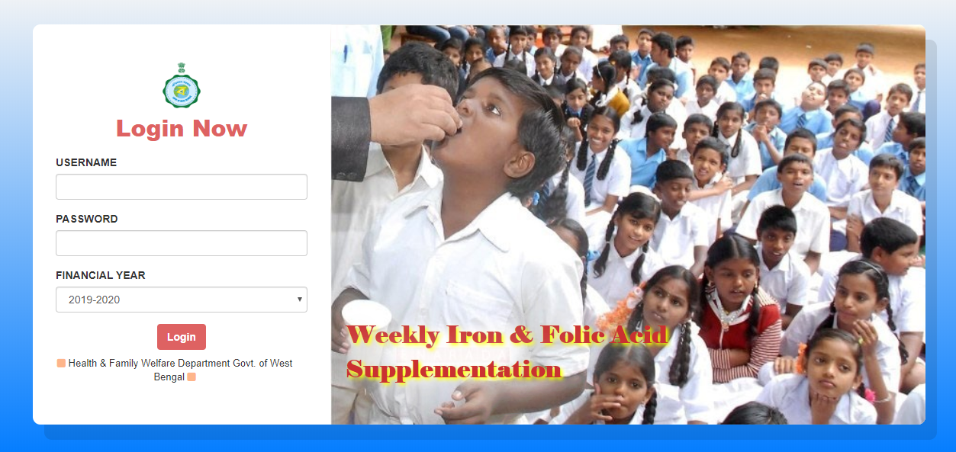
Weekly Iron & Folic Acid Supplementation workflow
School User can click on the logout option at any time from the menu ribbon
They will be redirected to the login page

Slide 20
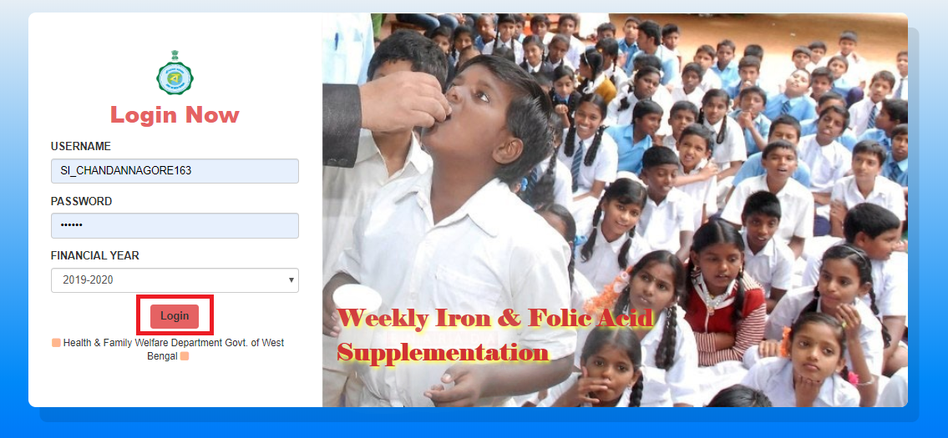
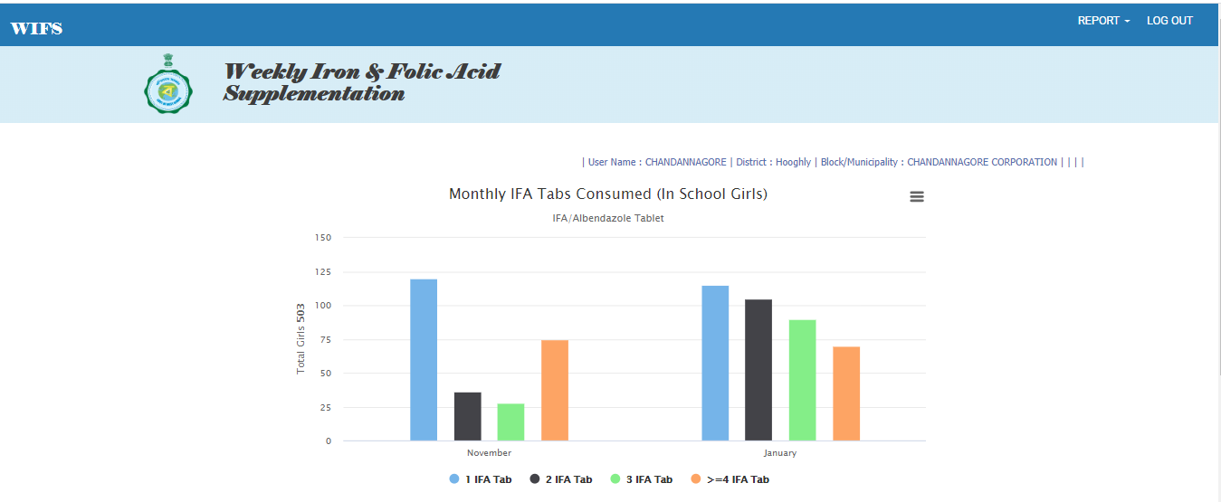
Weekly Iron & Folic Acid Supplementation workflow
Circle SI User Login to WIFS portal with their unique User credential
They will be redirected to Home page

Slide 21
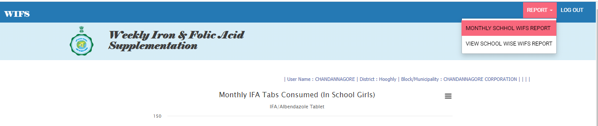
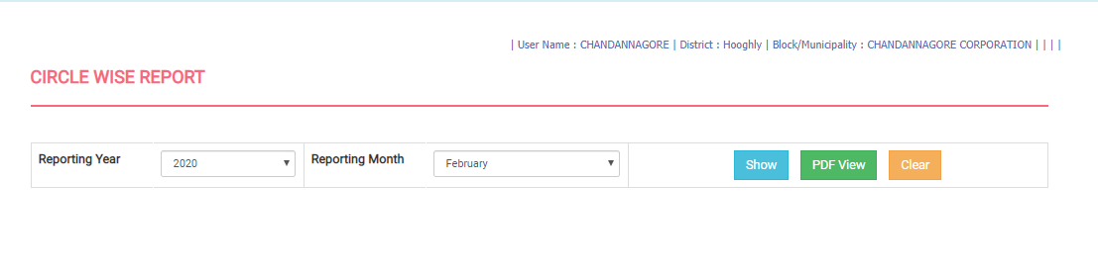
Weekly Iron & Folic Acid Supplementation workflow
Circle SI User will click on ‘Monthly School WIFS Report’ from report main menu
They will be redirected to ‘Monthly School WIFS Report’ page

Slide 22
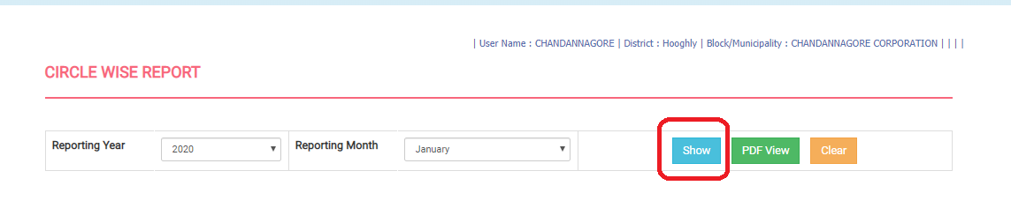
Weekly Iron & Folic Acid Supplementation workflow
Circle SI User will first provide required Reporting Year, Reporting Month and click on 'Show' button. User will be able to export the report in PDF by clicking ‘Download as PDF file’.

Slide 23
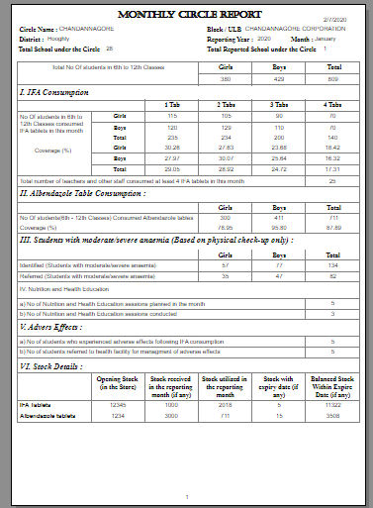
Weekly Iron & Folic Acid Supplementation workflow
Upon clicking on 'Show' button the Monthly School WIFS Report will generated in the next page

Slide 24
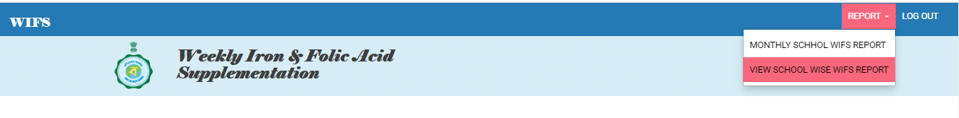
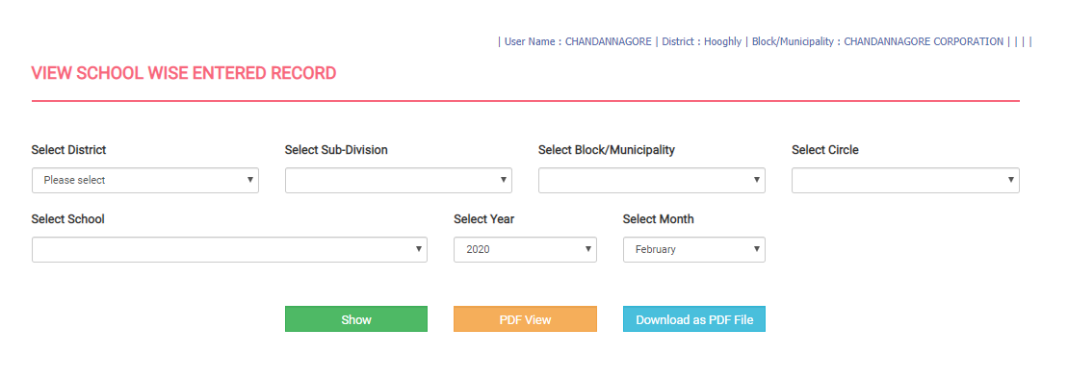
Weekly Iron & Folic Acid Supplementation workflow
Circle SI User Login to WIFS portal with their unique User credential
They will be redirected to Home page

Slide 25
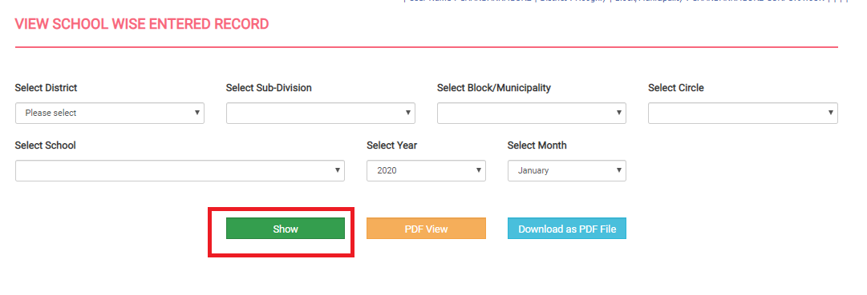
Weekly Iron & Folic Acid Supplementation workflow
Circle SI User Login to WIFS portal with their unique User credential

Slide 26
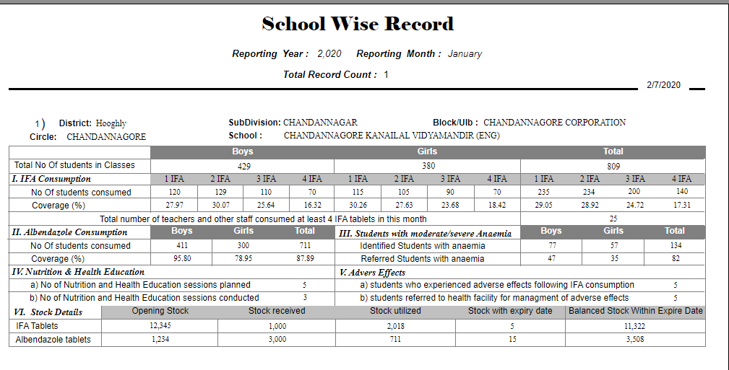
Weekly Iron & Folic Acid Supplementation workflow
Circle SI User Login to WIFS portal with their unique User credential

Slide 27
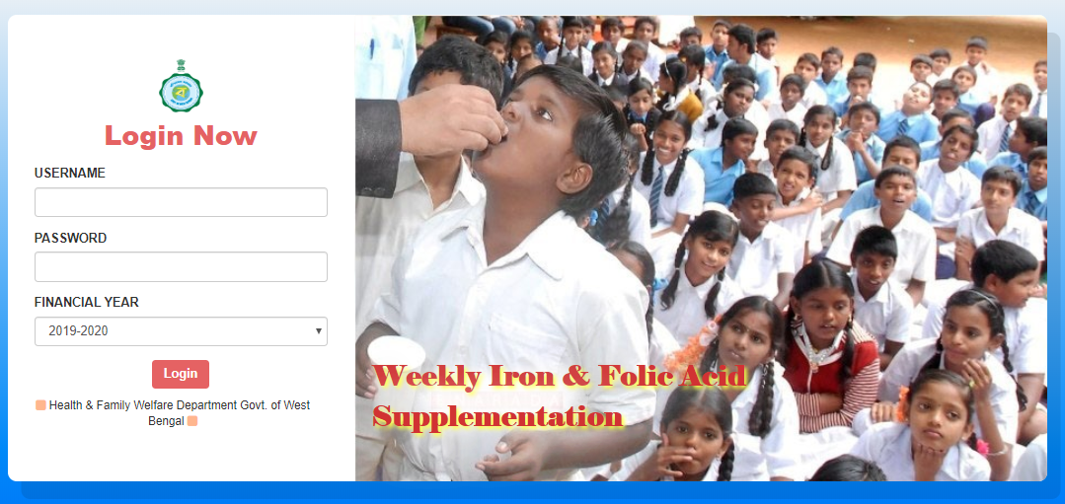
Weekly Iron & Folic Acid Supplementation workflow
Circle SI User can click on the logout option at any time from the menu ribbon
They will be redirected to the login page

Slide 28
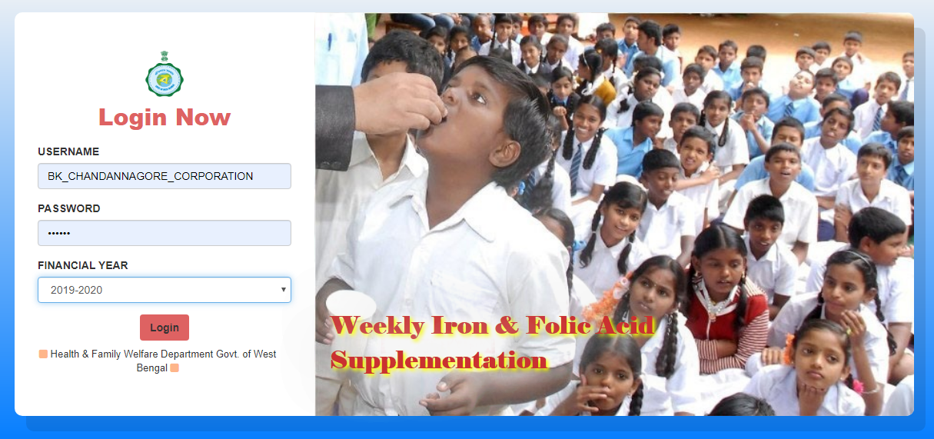
Weekly Iron & Folic Acid Supplementation workflow
BMOH User Login to WIFS portal with their unique User credential

Slide 29
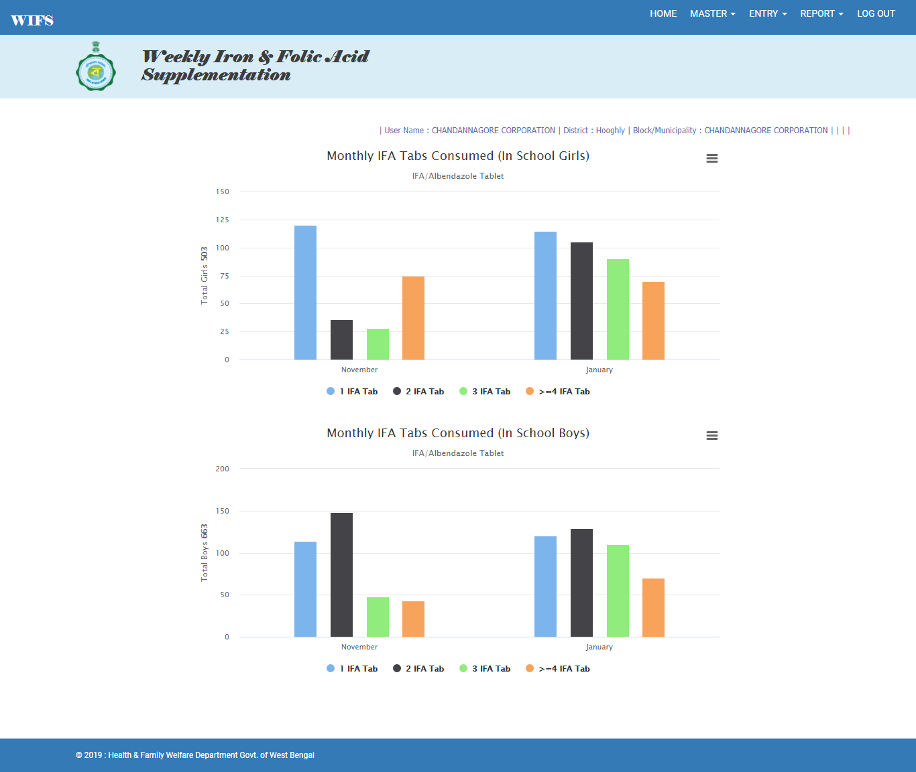
Weekly Iron & Folic Acid Supplementation workflow
BMOH User redirected to the Home page

Slide 30
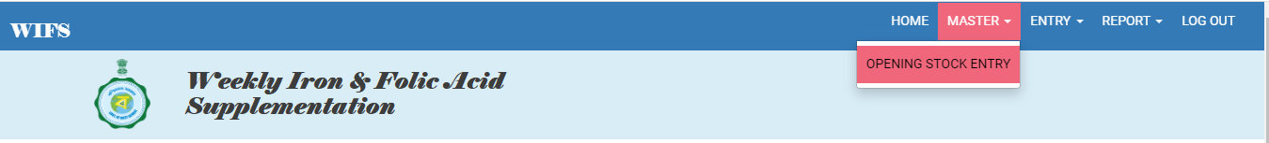
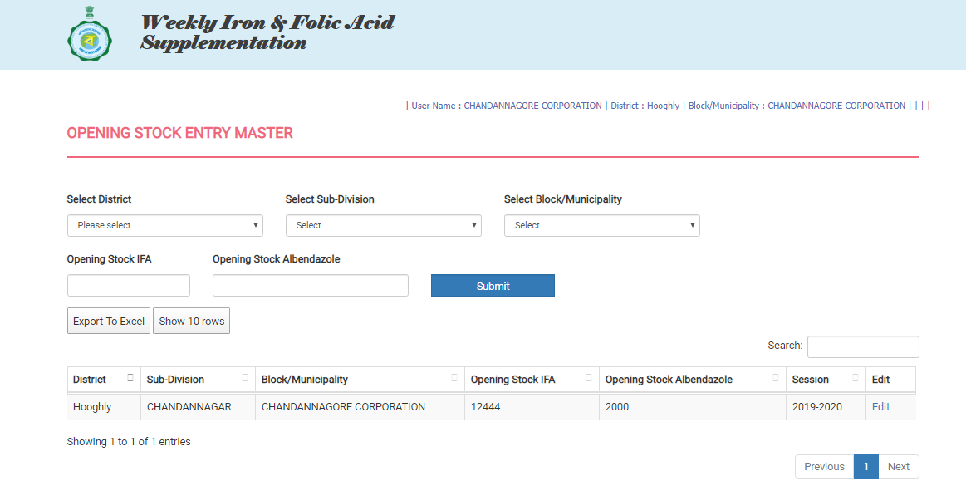
Weekly Iron & Folic Acid Supplementation workflow
Block User will click on Opening Stock Entry from Master Main Menu
Block User will redirect to the ‘Opening Stock Entry’ page

Slide 31
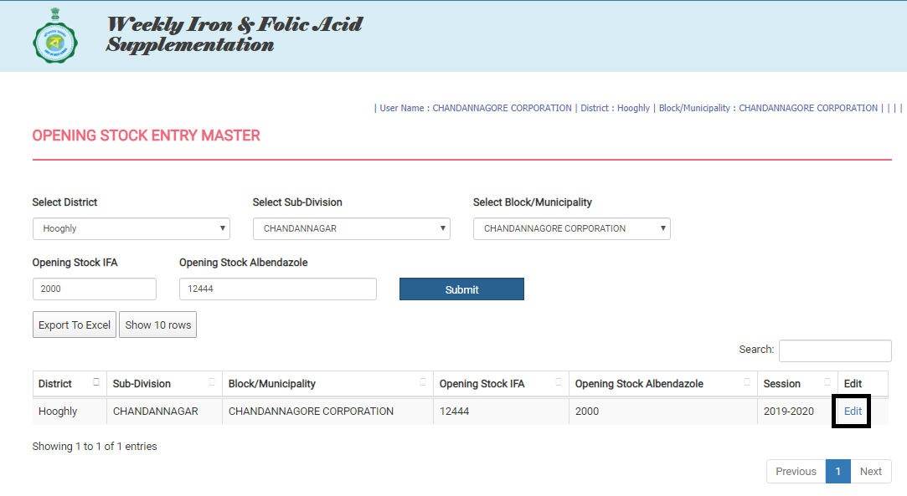
Weekly Iron & Folic Acid Supplementation workflow
Block User will click on edit button which populates some data. After that User will add Opening Stock IFA and Opening Stock Albendazole. Finally User will click Submit button to save the opening Stock entry

Slide 32
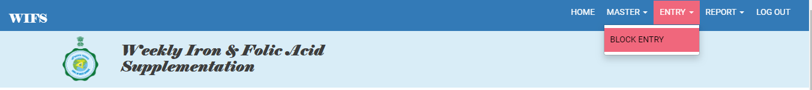
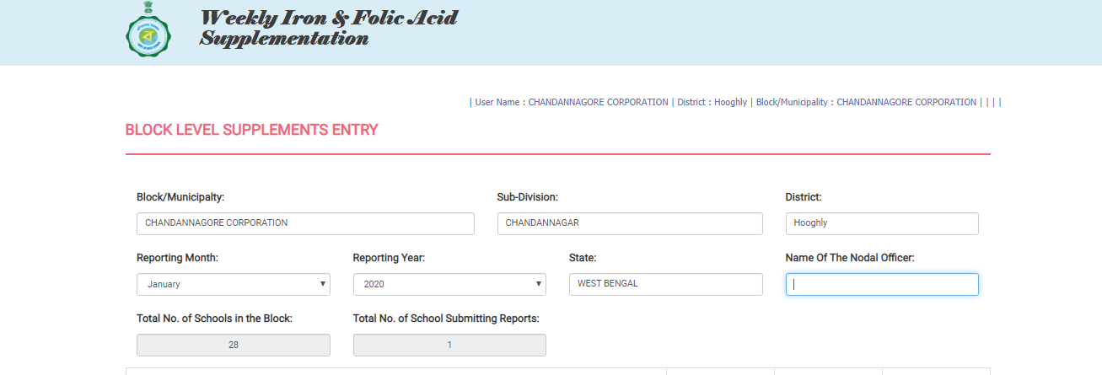
Weekly Iron & Folic Acid Supplementation workflow
Block User will click on Block Entry from Entry Main Menu
The page will redirect to the “Block Entry” Page

Slide 33
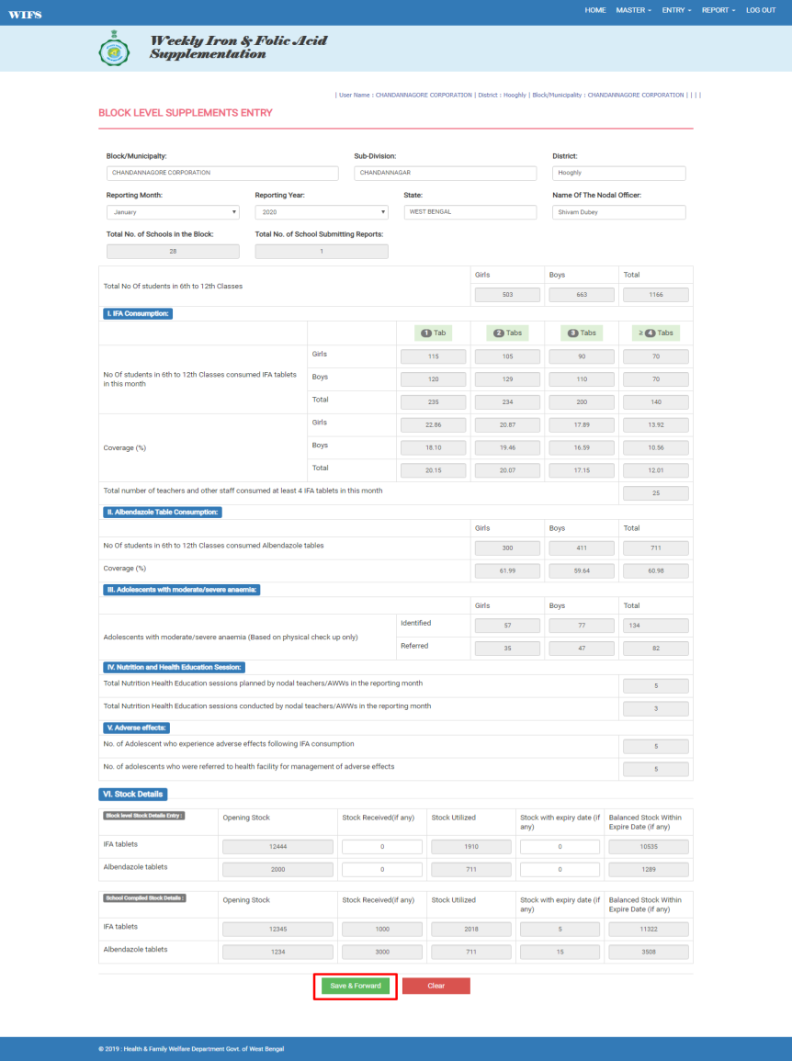
Weekly Iron & Folic Acid Supplementation workflow
In the first section the BMOH will view basic information like Block/ Municipality, Sub Division, District, State and selects Reporting Month And Year. After that they will enter Name of the BMOH. By default "Total No. of Schools (including Govt./ Govt. Aided/ Residential) Schools in the Block" and "Total No. of School Submitting Reports from Education Dept." populates. The Rest of the Sections will be auto filled from the information provided by Schools and C.D.P.O. These sections will not be editable for the BMOH. The Final Section is where the BMOH will view details about the Supply Details of IFA and Albendazole tablets utilized in the months, Balance Stock with expiry date and Stock needed (if any).

Slide 34
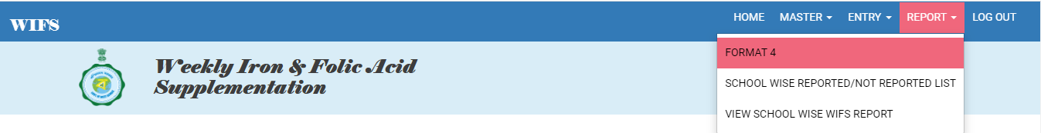
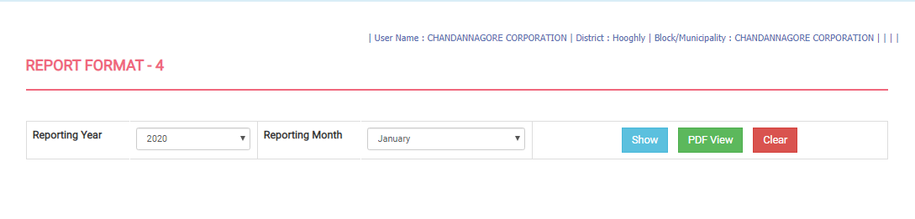
Weekly Iron & Folic Acid Supplementation workflow
Block User Clicks on ‘Format 4’ from Report main menu
The page redirected to the Format 4 page

Slide 35
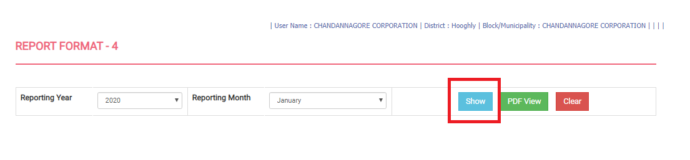
Weekly Iron & Folic Acid Supplementation workflow
Block User clicks on ‘Show’ button after selecting Reporting year and month

Slide 36
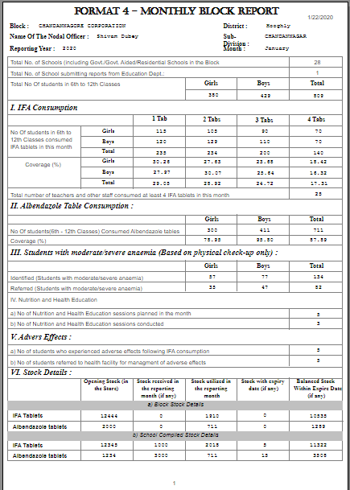
Weekly Iron & Folic Acid Supplementation workflow
A new page will open with the searched report

Slide 37
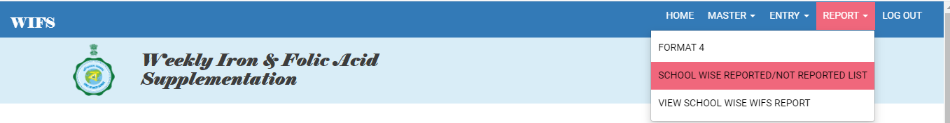
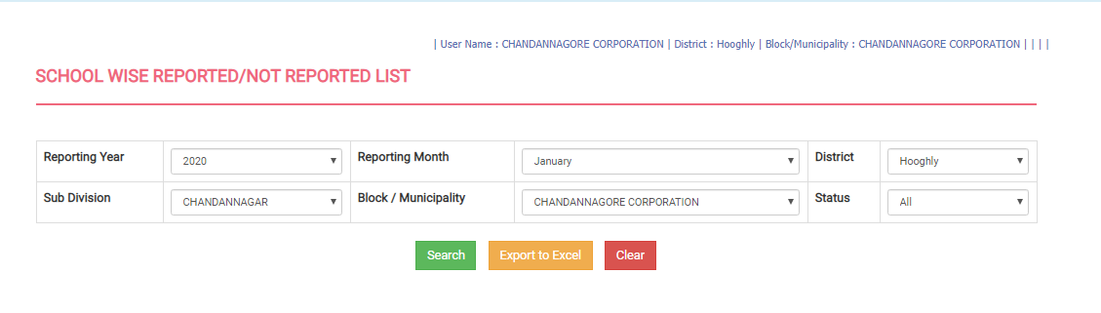
Weekly Iron & Folic Acid Supplementation workflow
Block User Clicks on ‘School Wise Reported and Not Reported list’ from Report main menu
Block User redirected to the ‘School Wise Reported and Not Reported list’ page

Slide 38

Weekly Iron & Folic Acid Supplementation workflow
Block User will click on search button which fetches entire school on their region with the status school reported or not. User can also click on ‘Export to Excel’ button to download the report in excel

Slide 39


Weekly Iron & Folic Acid Supplementation workflow
Block User will click on “School Wise Report” from “Report” main menu
Block User will redirect to the “School Wise Report” page

Slide 40


Weekly Iron & Folic Acid Supplementation workflow
User will click on ‘Show’ button after entering required fields. It can be open in PDF view or can be downloaded as PDF also.
Upon clicking on show button the report will be open in the next tab.

Slide 41


Weekly Iron & Folic Acid Supplementation workflow
Block User can click on the logout option at any time from the menu ribbon
They will be redirected to the login page

Slide 42


Weekly Iron & Folic Acid Supplementation workflow
CDPO User Login to WIFS portal with their unique User credential
CDPO User redirected to the Home page

Slide 43


Weekly Iron & Folic Acid Supplementation workflow
CDPO User clicks on CDPO master from Master main Menu
CDPO User redirected t to the CDPO master page

Slide 44


Weekly Iron & Folic Acid Supplementation workflow
CDPO User can click on edit button to update their details

Slide 45

Weekly Iron & Folic Acid Supplementation workflow
CDPO User clicks on CDPO Entry from Master main Menu

Slide 46

Weekly Iron & Folic Acid Supplementation workflow
CDPO User redirected to the CDPO entry page

Slide 47
Weekly Iron & Folic Acid Supplementation workflow
CDPO User entered the required details and forwarded it to District User

Slide 48


Weekly Iron & Folic Acid Supplementation workflow
C.D.P.O. User will click on ‘Format 3’ from Report menu to view the report
The page will be navigated to the report page

Slide 49

Weekly Iron & Folic Acid Supplementation workflow
Over here the C.D.P.O. User will select Reporting Year and Reporting Month and finally click on ‘Show’ to view the Report

Slide 50

Weekly Iron & Folic Acid Supplementation workflow
CDPO User will view the required report accordingly

Slide 51

Weekly Iron & Folic Acid Supplementation workflow
CDPO User can click on the logout option at any time from the menu ribbon
They will be redirected to the login page

Slide 52

Weekly Iron & Folic Acid Supplementation workflow
District User Login to WIFS portal with their unique User credential

Slide 53

Weekly Iron & Folic Acid Supplementation workflow
District User redirected to the Home page

Slide 54

Weekly Iron & Folic Acid Supplementation workflow
District User will click on ‘Opening Stock Entry’ from ‘Master’ main menu
The page will redirect to the ‘Opening Stock Entry’ page

Slide 55


Weekly Iron & Folic Acid Supplementation workflow
For entering opening stock User will click on edit hyperlink, which opens the pre-populated data which has provided by School previously.
District User will enter the opening stock and click on submit button which stores the opening entry accordingly.

Slide 56

Weekly Iron & Folic Acid Supplementation workflow
District User will click on ‘District Entry’ from ‘Entry’ main menu
The page will redirect to the ‘District Entry’ page

Slide 57

Weekly Iron & Folic Acid Supplementation workflow
District User will enter the Nodal Officer name and their details and check the entries of all school or CDPO. And click on Save & forward button

Slide 58


Weekly Iron & Folic Acid Supplementation workflow
District User will click on Format 5 from the Report menu ribbon
District User redirected to the Format 5 page.

Slide 59

Weekly Iron & Folic Acid Supplementation workflow
District User will click on ‘Show’ button after entering required reporting Year & Month

Slide 60


Weekly Iron & Folic Acid Supplementation workflow
District User will view the report of the same reporting Year & Month in a new page

Slide 61


Weekly Iron & Folic Acid Supplementation workflow
District User will click on School Wise Reported / Not Reported List from the Report menu ribbon
District User redirected to the School Wise Reported / Not Reported List page.

Slide 62


Weekly Iron & Folic Acid Supplementation workflow
District User will click on ‘Search’ button after entering required fields

Slide 63


Weekly Iron & Folic Acid Supplementation workflow
District User will click on CDPO Wise Reported / Not Reported List from the Report menu ribbon
District User redirected to the CDPO Wise Reported / Not Reported List page.

Slide 64

Weekly Iron & Folic Acid Supplementation workflow
District User will click on ‘Search’ button after entering required fields

Slide 65


Weekly Iron & Folic Acid Supplementation workflow
District User will click on View School Wise WIFS Report from the Report menu ribbon
District User redirected to the View School Wise WIFS Report page.

Slide 66

Weekly Iron & Folic Acid Supplementation workflow
District User will click on ‘Search’ button after entering required fields

Slide 67

Weekly Iron & Folic Acid Supplementation workflow
Upon clicking on 'Show' button the School wise WIFS report will generated in the next page.

Slide 68


Weekly Iron & Folic Acid Supplementation workflow
To view the report “View ICDS Project Wise Entered Report“, the District User will click on ‘View ICDS Project Wise Entered Report’ from the main menu ‘Report’
The page will redirect to the ‘View ICDS Project Wise Entered Report‘ page

Slide 69

Weekly Iron & Folic Acid Supplementation workflow
District User will click on ‘Search’ button after entering required fields

Slide 70

Weekly Iron & Folic Acid Supplementation workflow
District User will view the report of the same searched criteria

Slide 71


Weekly Iron & Folic Acid Supplementation workflow
District User can click on the logout option at any time from the menu ribbon
They will be redirected to the login page

Slide 72

THANK YOU

